Slide 1
CUSTOMER RETENTION
RAVI PRAKASH BAJPAI

Slide 2
INTRODUCTION
This project deal with the business related to e commerce platform like amazon ,flipkart and other.
In this project how customer can be retented or how customer can be facilitated so that he may shop again.
This project is beneficial for e commerce to check different aspect for satisfaction of customers so that customer may do purchase again from same e commerce platform

Slide 3
DATA CLEANING AND PREPROCESSING
Data Sources and their formats
Data for this project was already provided to us by our team from flip robo. Features in the data are of both the type that is object and numeric.
Data Preprocessing Done
It can be observed from jupyer notebook that there is no features with missing data or having null value.
it contains 47 numeric data type features and rest were in object data type.

Slide 4
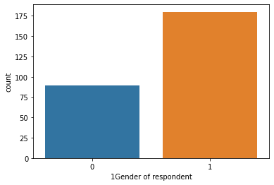
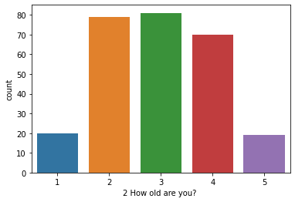
Visualizations 1 and 2
Count plot

Slide 5
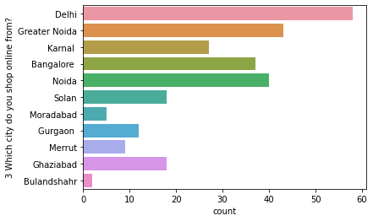
Visualizations 3
Count plot

Slide 6
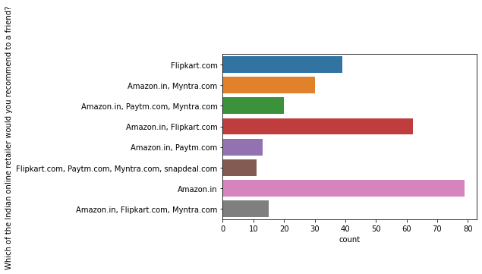
Visualizations 4
Countplot

Slide 7
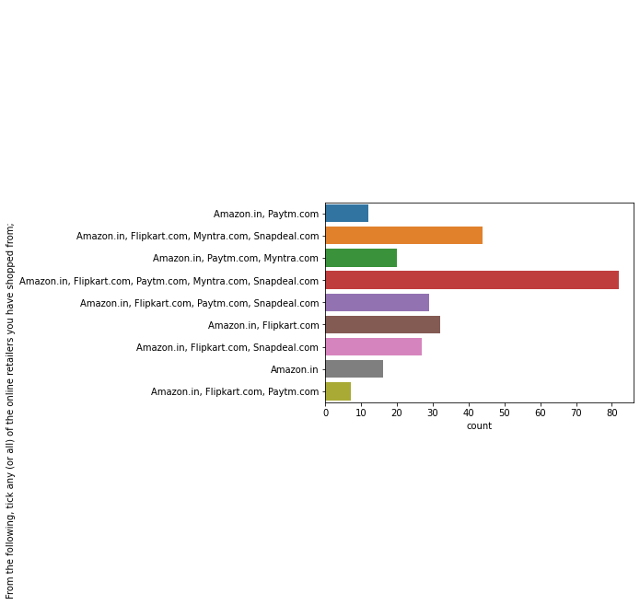
Visualizations 5

Slide 8
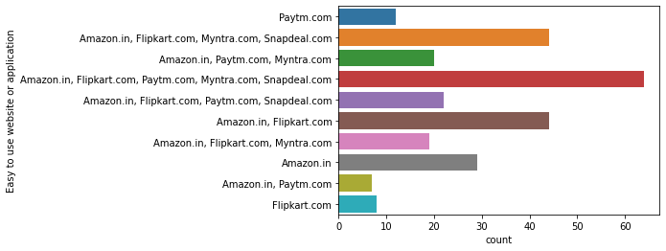
Visualizations 6

Slide 9
Observations for above visualization
It can be inferred that gender of type 1 are shoping more than 0 type gender.
It can be observed from count plot that type 2,3,4 are more in number as compare to 1 and 5.
It can be observed that from delhi there are maximum number of customer and from bulandshahr there are very less number of customers.
It can seen from graph that alone amazon is covering larger numbers of customers.
It can observed from graph 5 that customer prefer amazon at most after that flipkart and other. How customer has set their shoping preference can be observed.
Main priority is g.iven to amazon than flipkart for easy to use application.

Slide 10
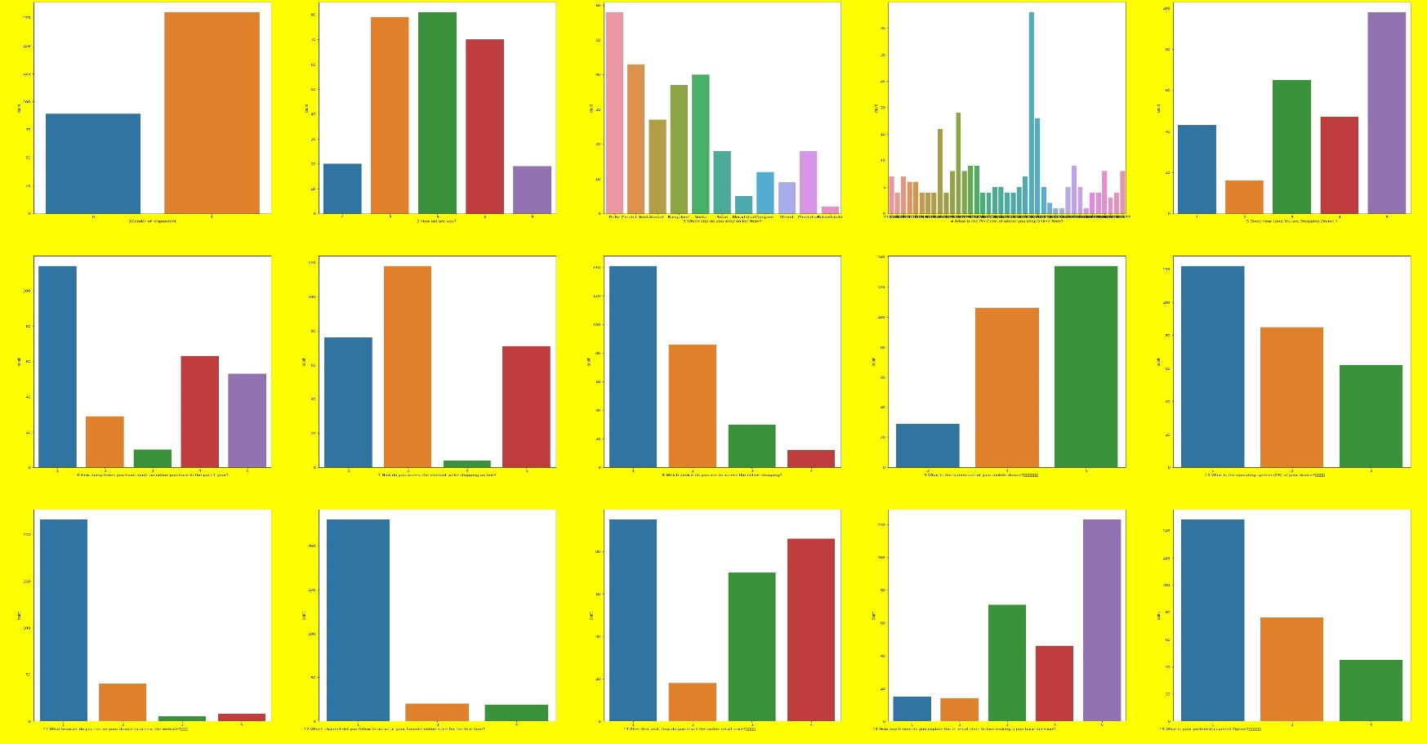
Visualizations count plot for all features

Slide 11
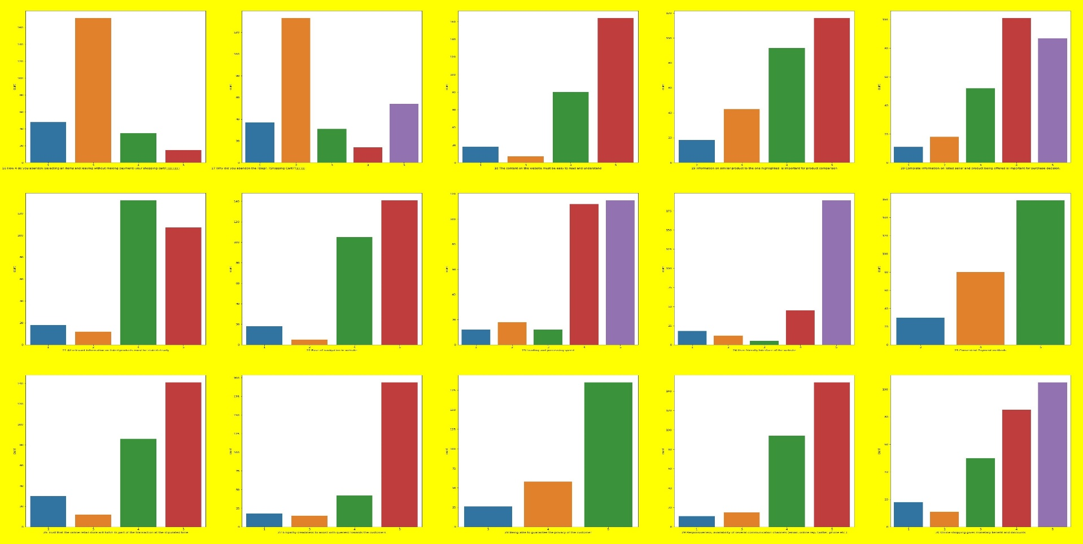
Visualizations count plot for all features

Slide 12
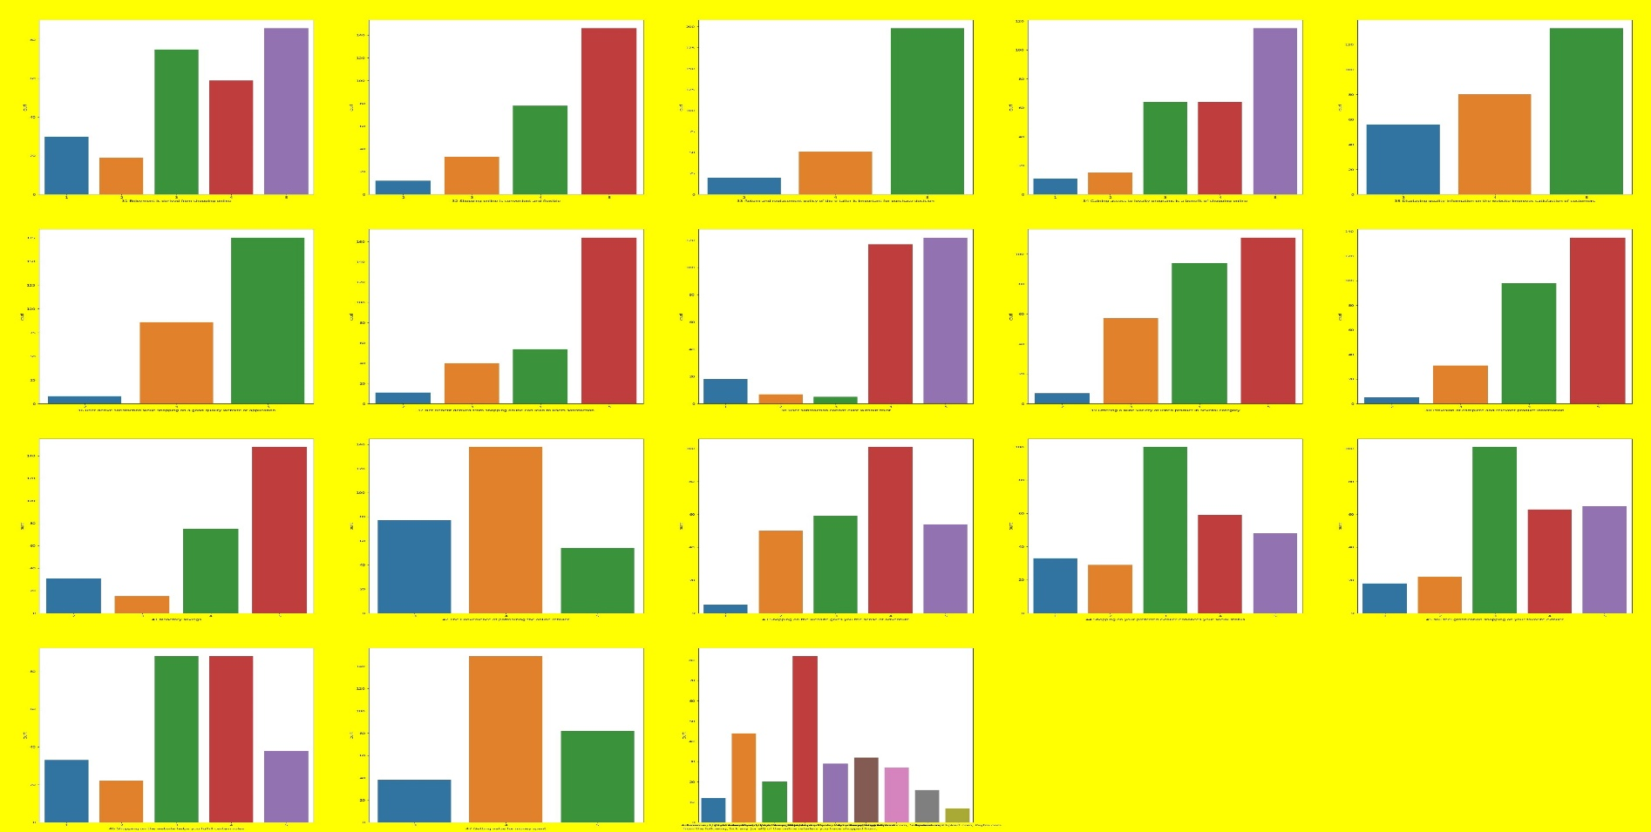
Visualizations count plot for all features

Slide 13
Conclusion
From the given model it is concluded that for each features analysis can be done. We can make analysis on many other features in such a way that only focusing on particular values of features great improvement can be done. We can also make interpretation which is maximum and which is minimum for any features.

